Slide 1



RETAIL
SOLUTIONS
BUILDERS

Slide 2
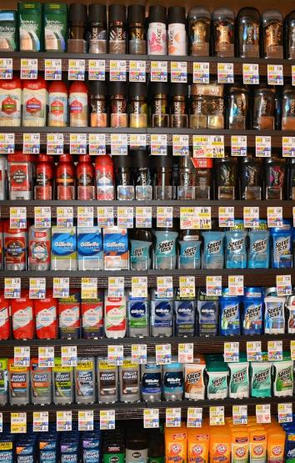
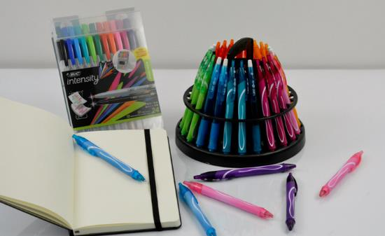
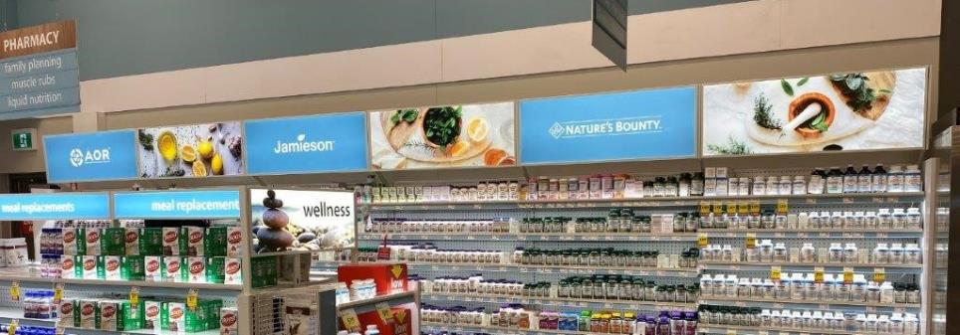
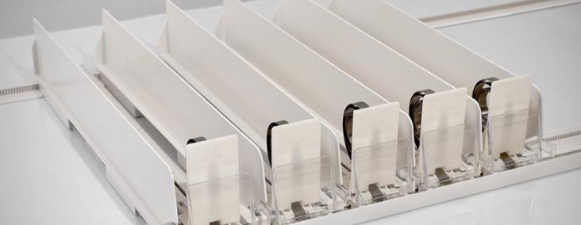



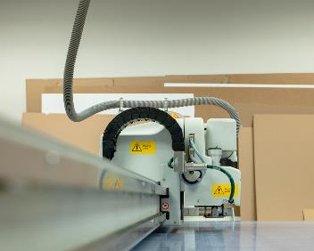

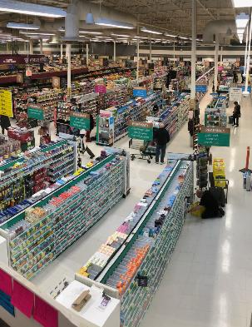


RETAIL

Slide 3

Innovating Retail Success
Turning POS into ROI takes a retail marketing partner that has as much passion and creativity as proven experience:
EZLoad Shelf Systems
G3® - 3rd Generation EZLoad
EZLoad L.E.D. – Illumination
Two-Tier Solutions

Slide 4

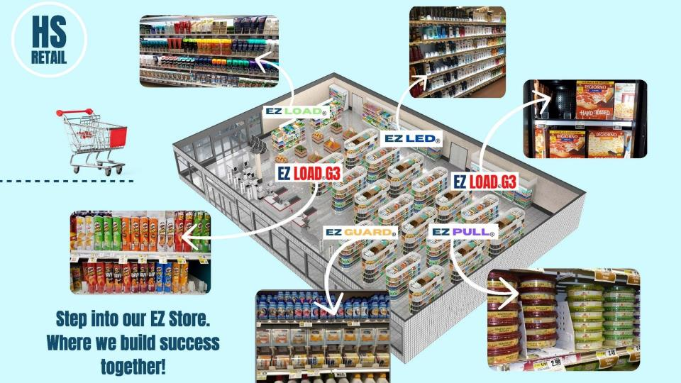
Features
Easy set up: 3’ and 4’ rails
Attaches to retail shelving
Fits 10” – 24” shelf depths
Prevents sweeping
Theft deterrent
Reduces restocking time
Saves labor hours
Unique hinged front lens
Enables one handed
restocking
Re-set POG’s in minutes

Slide 5
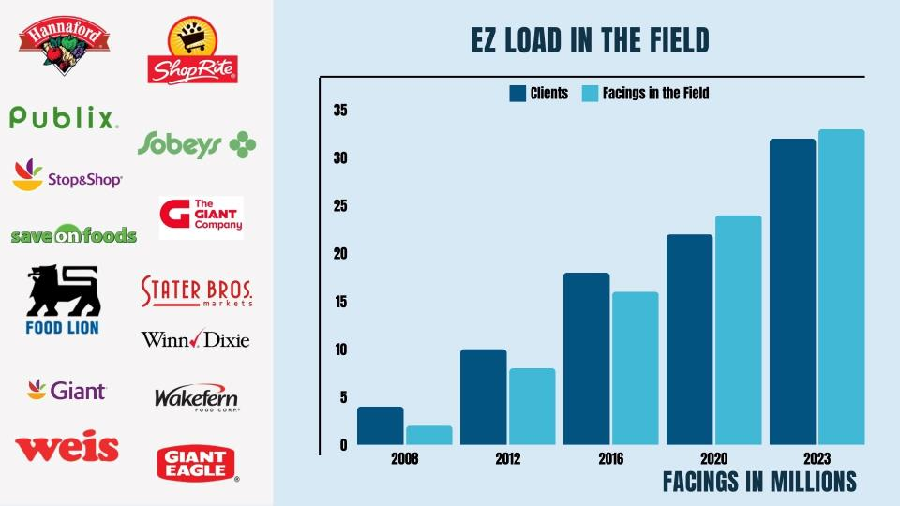
Marketplace

Slide 6
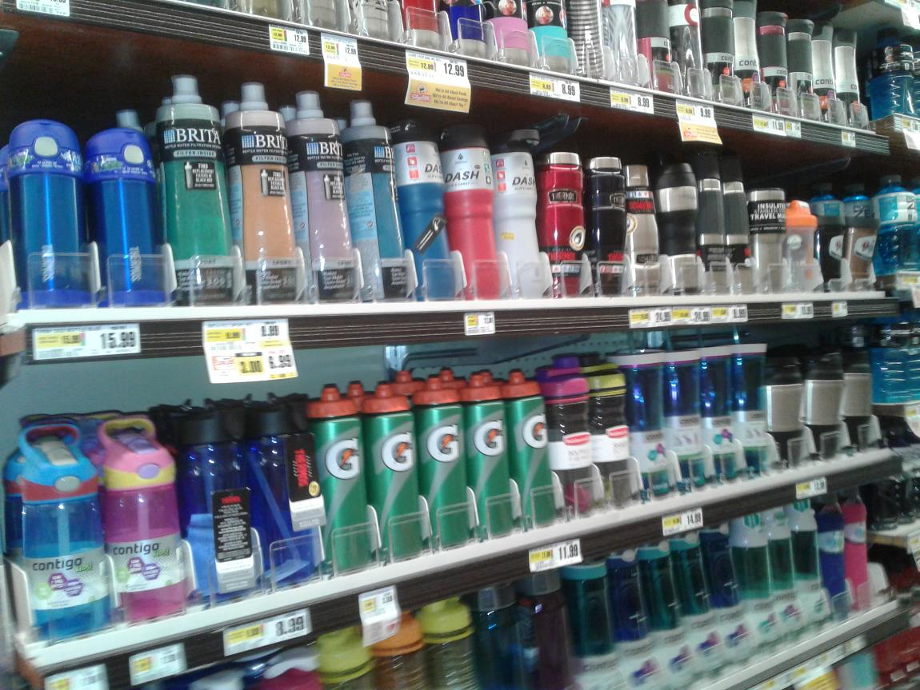
G3® Locking System:
48” front and back rail
Locking center
Dividers – 18” – 22”
Folding front lens
Easy installation
Ideal for rounded products

Slide 7
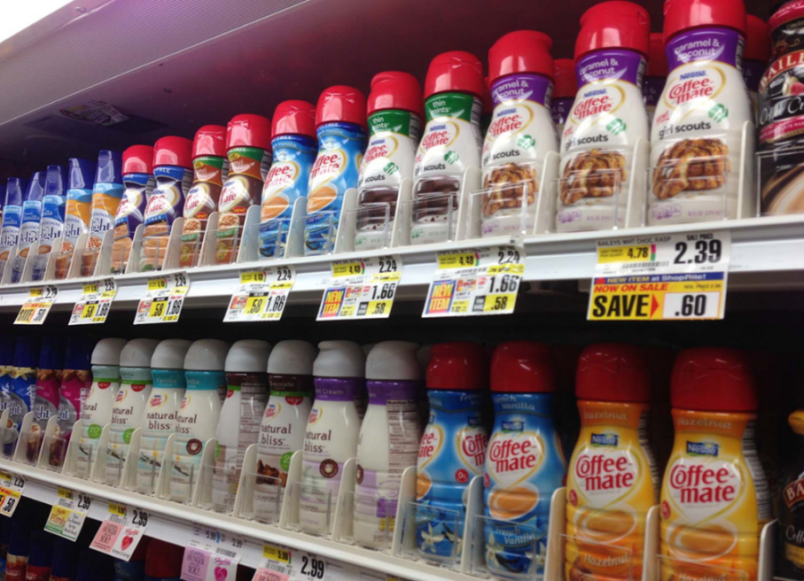
Features
Easy set up: 3’ and 4’ rails
Attaches to retail shelving
Fits 10” – 24” shelf depths
Prevents sweeping
Theft deterrent
Reduces restocking time
Saves labor hours
Unique hinged front lens
Enables one handed
restocking
Re-set POG’s in minutes

Slide 8
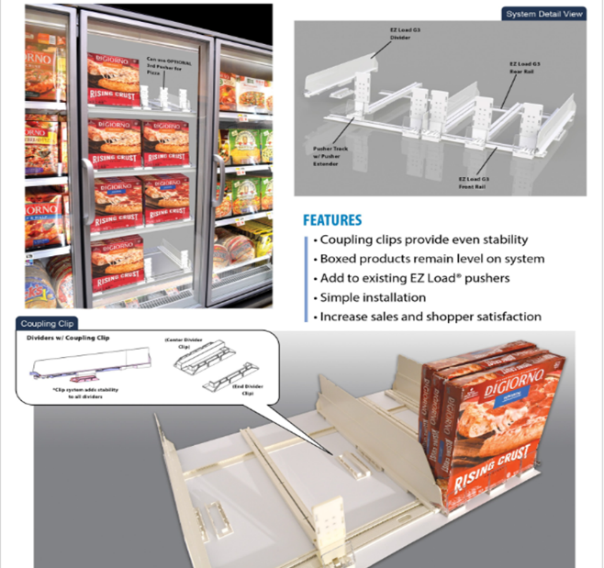
Frozen Solutions
Locking dividers for stability
Couples allows for more efficient push
Folding front lens
Easy installation

Slide 9
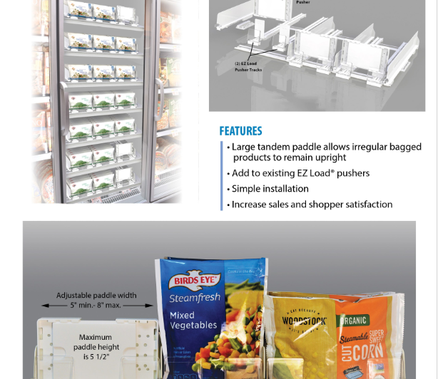
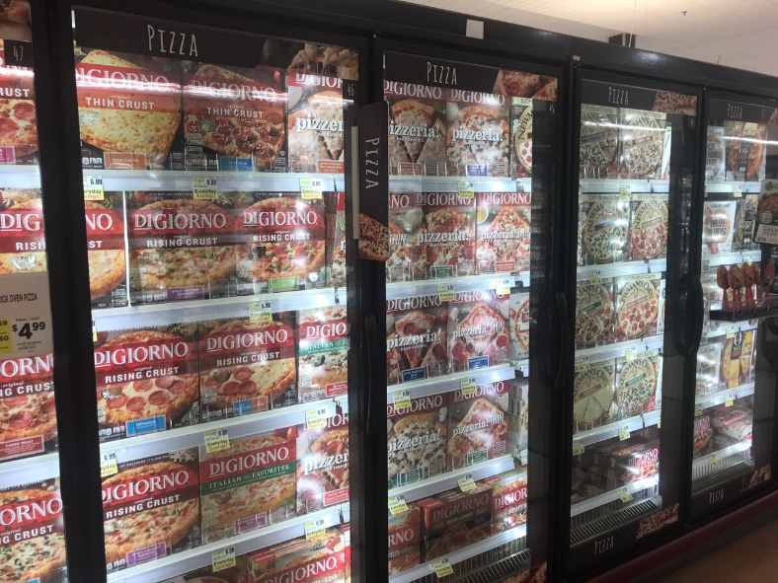
Frozen Solutions

Slide 10
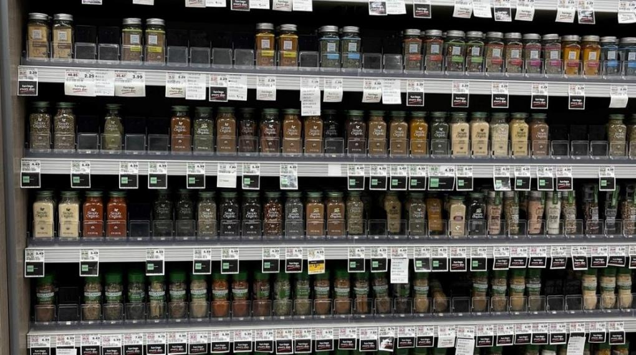
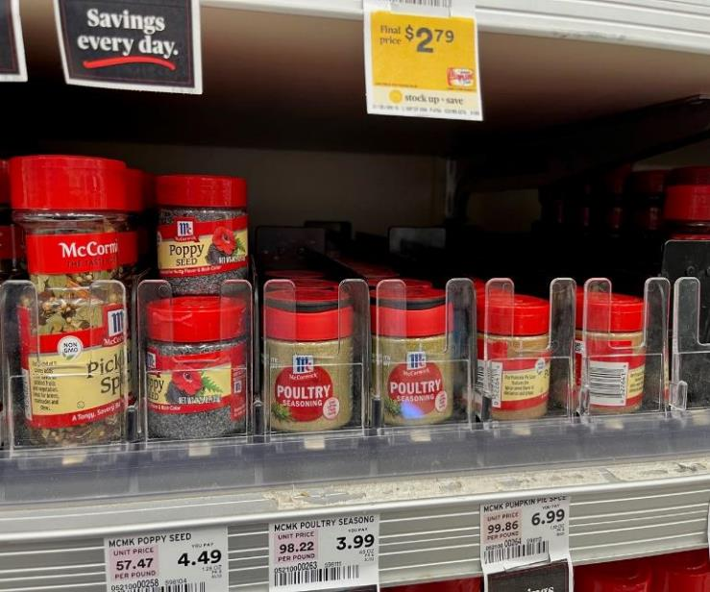
Center Store

Slide 11
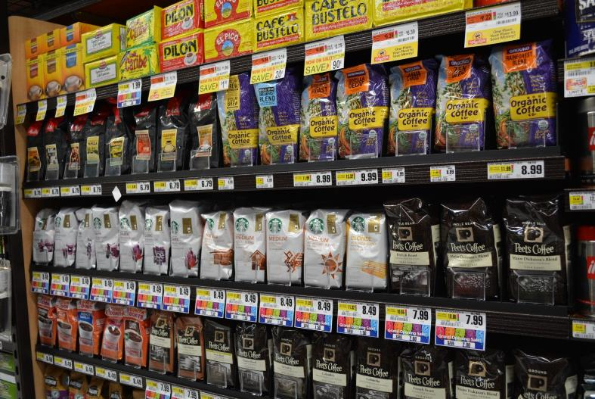
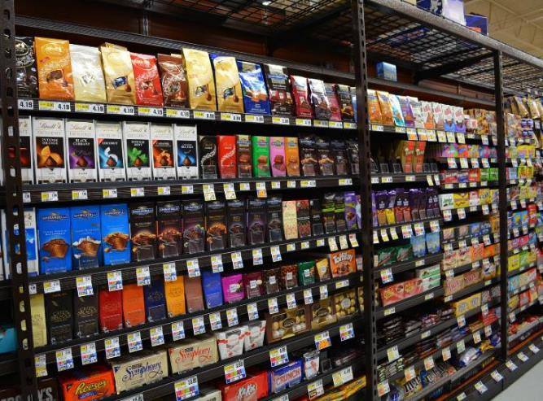
Center Store

Slide 12
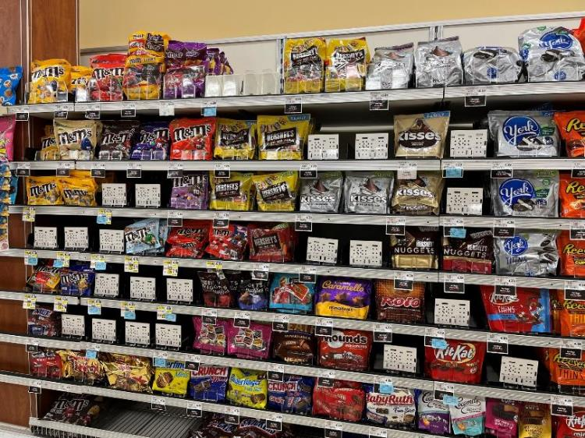
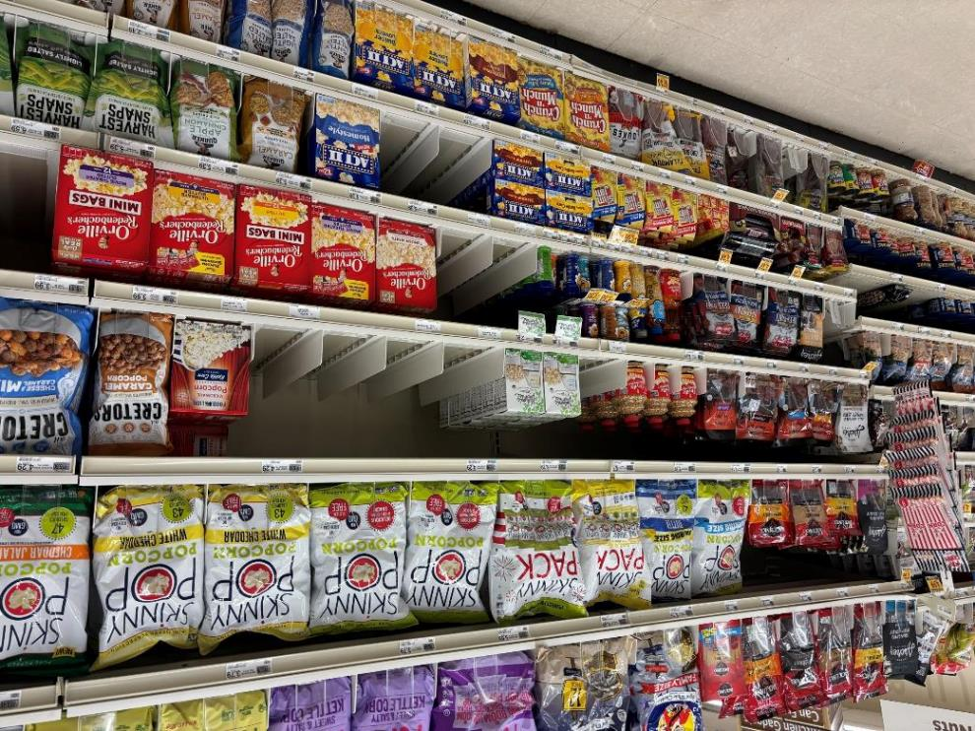
Center Store

Slide 13
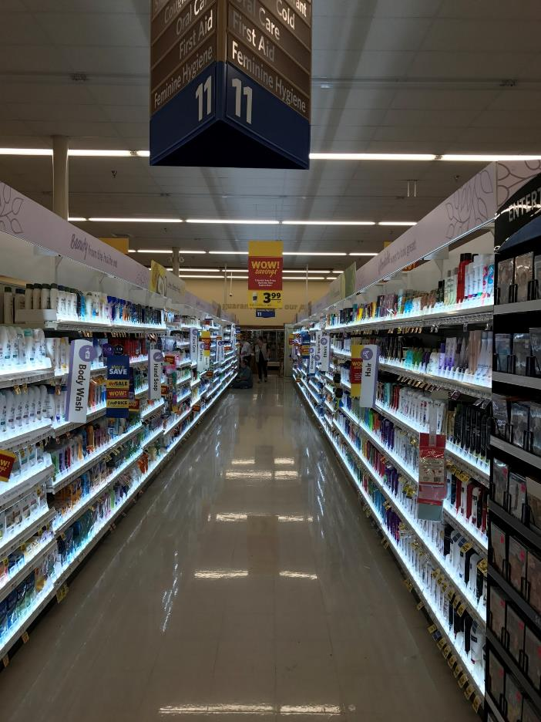
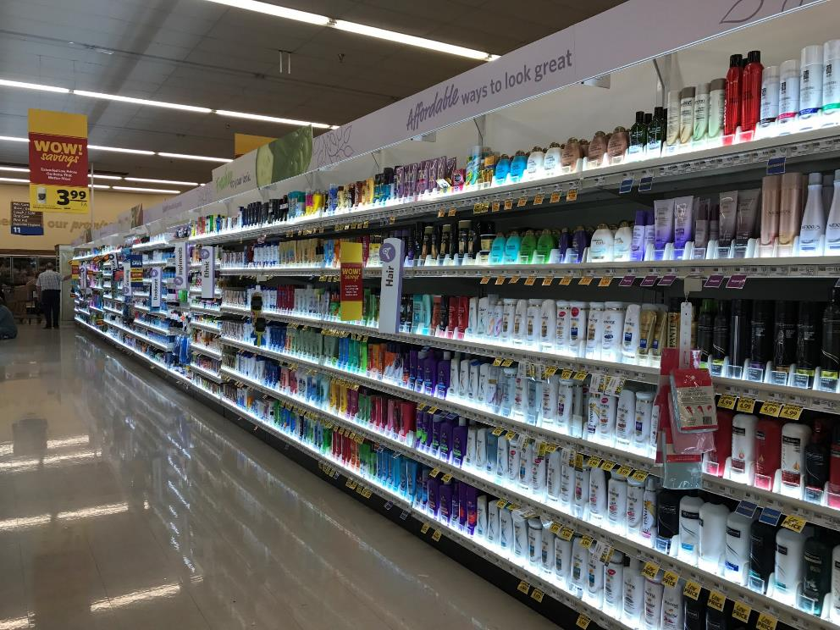
Illumination - HBA

Slide 14
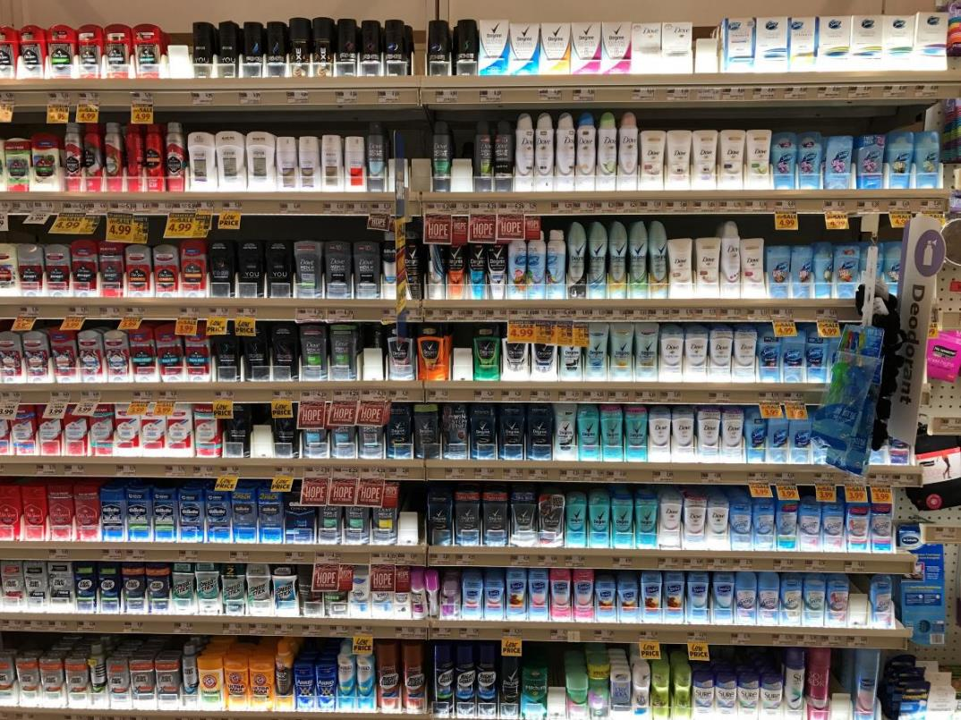

Illumination - HBA
LED Lights
Up and down options
Integrates with pusher systems

Slide 15
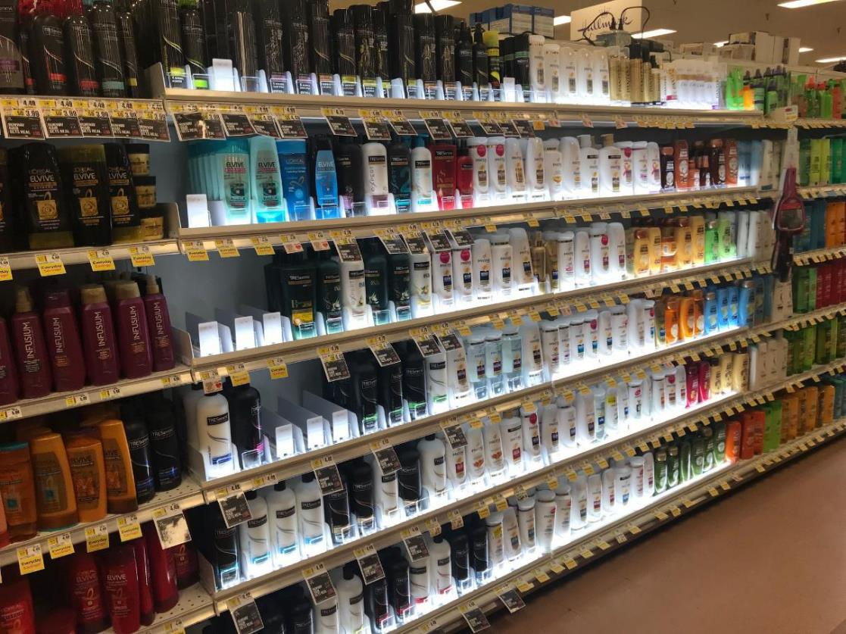
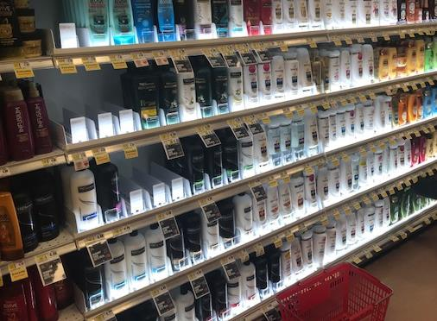
Illumination - HBA

Slide 16


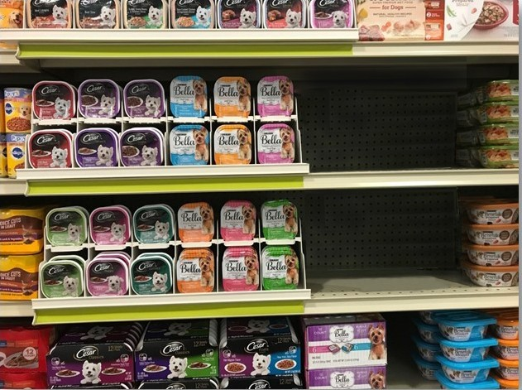
HS Two Tier Pet System
Merchandise different flavors, top over bottom, by adding our Two Tier System
Create more selling space by adding our Two Tier System
Add new SKU’s to your POG by adding our Two Tier System

Slide 17
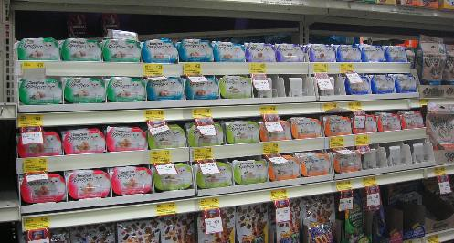
The Solution
Two Tier System doubles shelf capacity
Products remain neat & forward facing
Increase SKU’s on shelf
Serves as inventory management tool
Upright product increases visibility
Increase sales
Improve shopability
Modularity increases facings quickly and easily

Slide 18


HS Innovation
Sales Potential
Solves a Problem
Market Needs
Modular

Slide 19

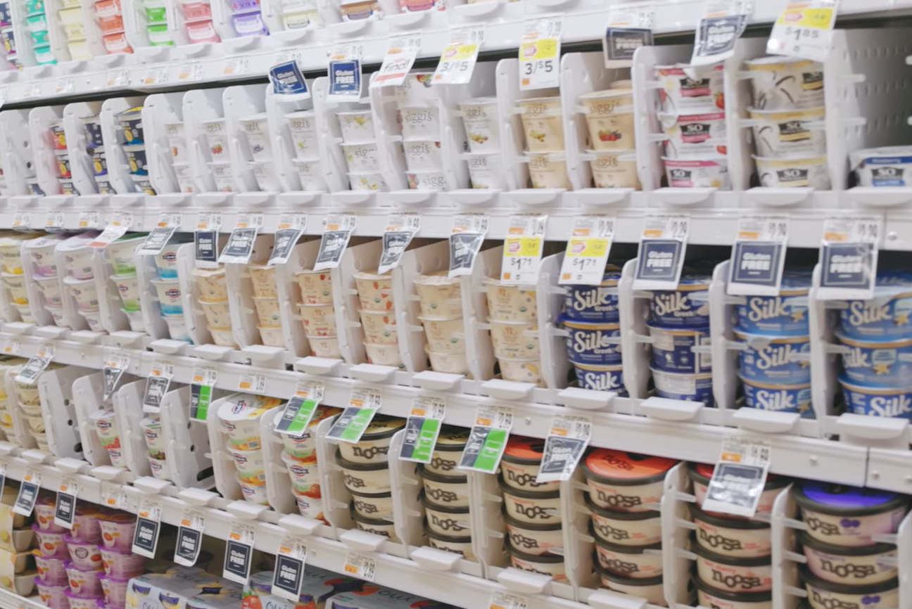
Our latest Innovation...

Slide 20
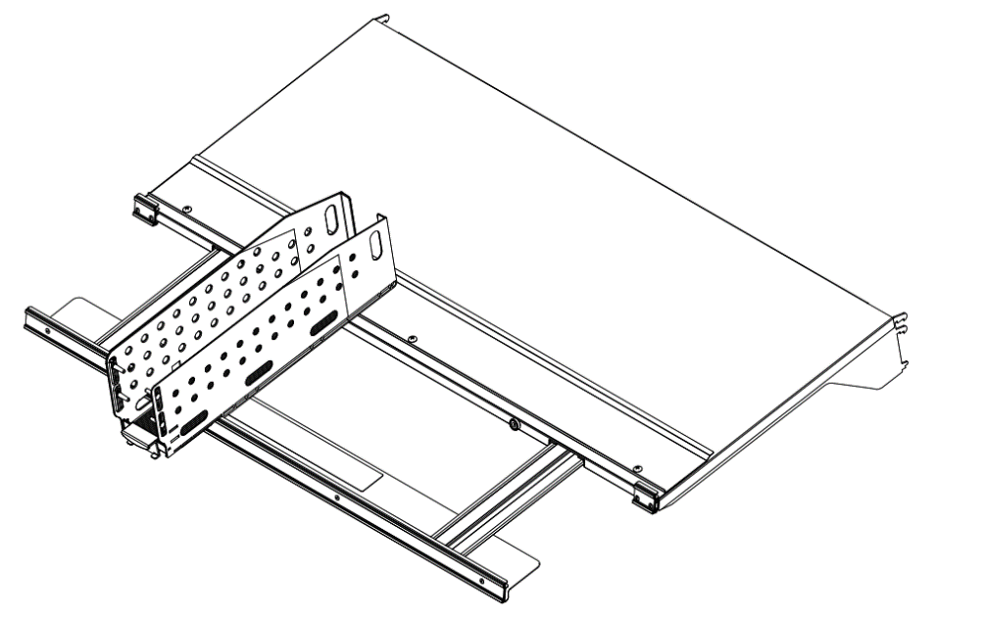
Features
Patented shelf and module design ease product rotation
Modular shelf with pull out bar - fits both coolers and gondolas
Expandable modules that lock at desired width

Slide 21

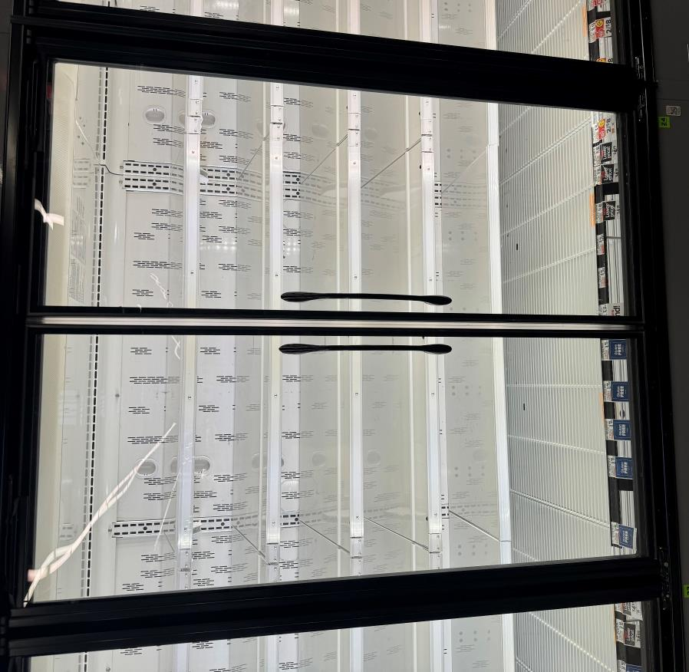
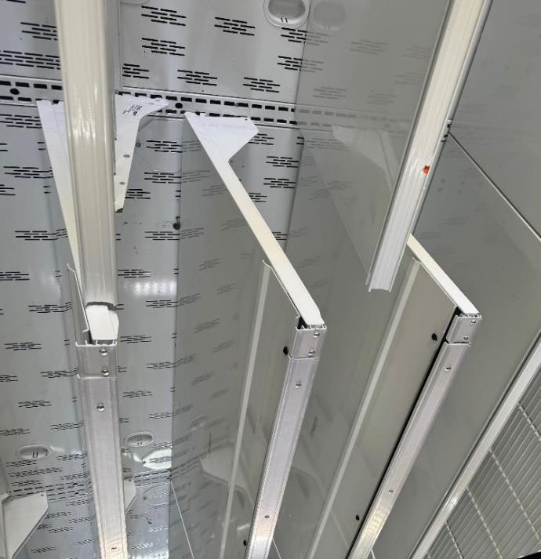
Installation in stores

Slide 22
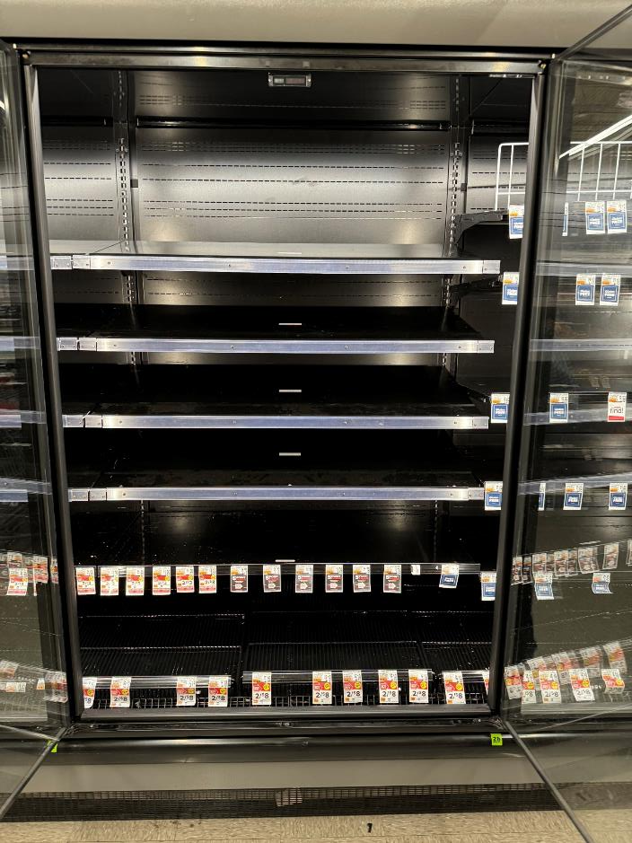
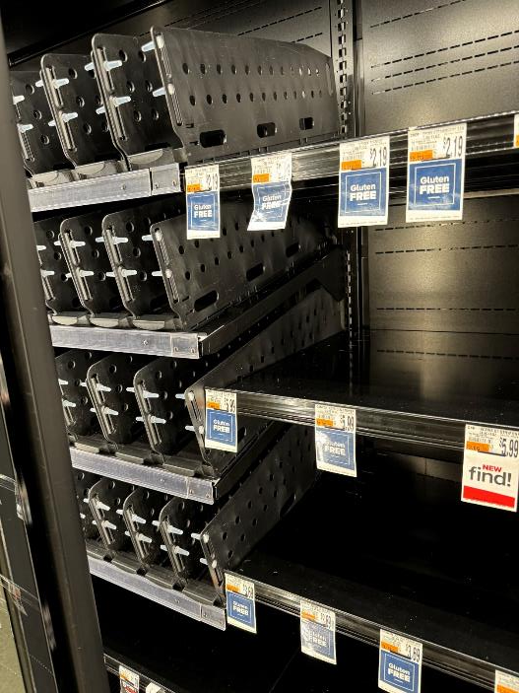
Installation in stores

Slide 23
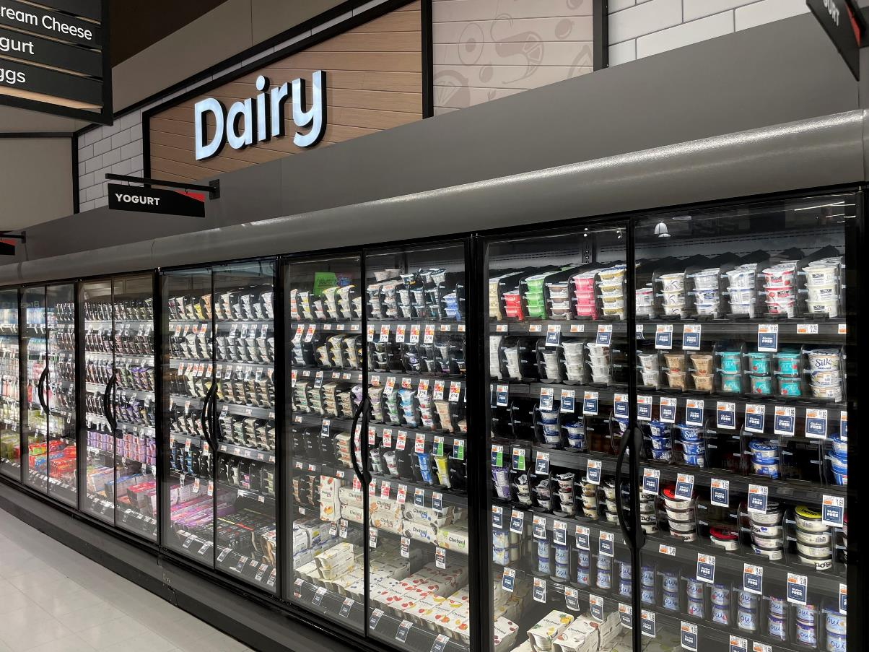
Completed installation:
20’ of single serve yogurt

Slide 24
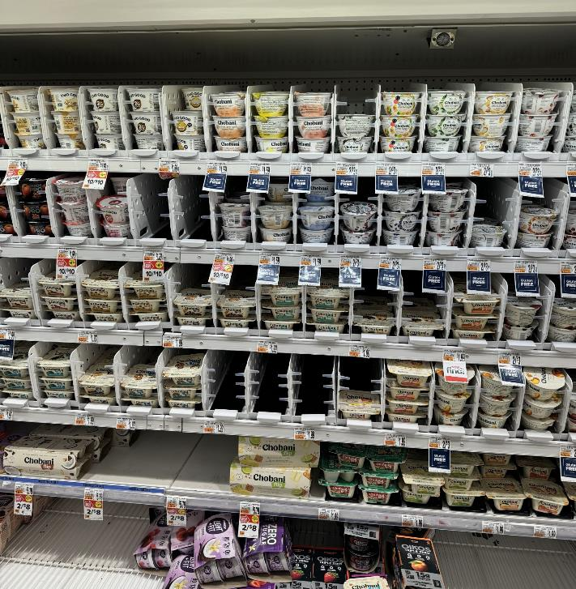
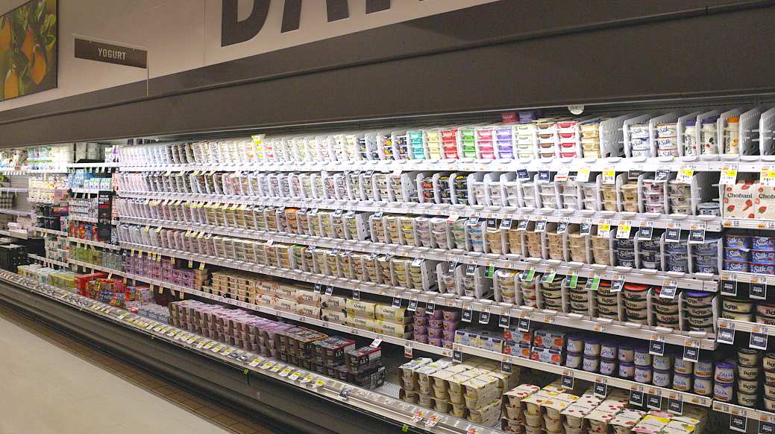
Completed installation for open air coolers

Slide 25
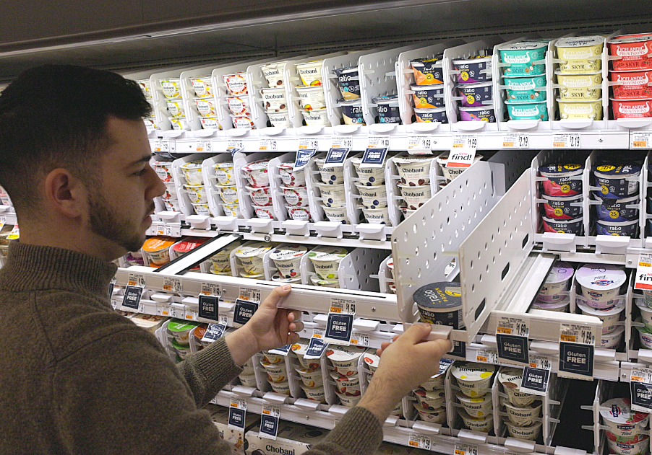
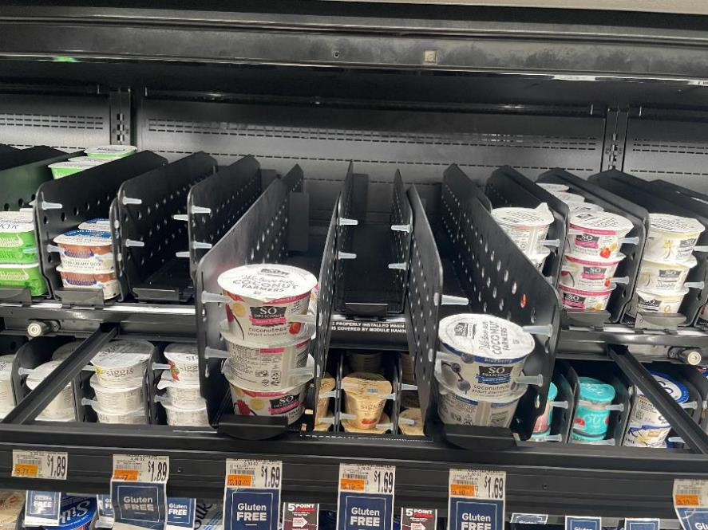
Pullout bar in action
Modules pull out and rest on bar for easy loading and improved product rotation

Slide 26

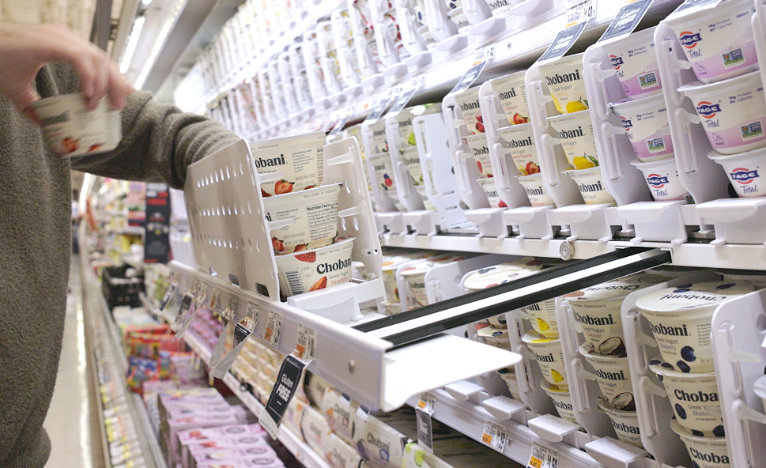
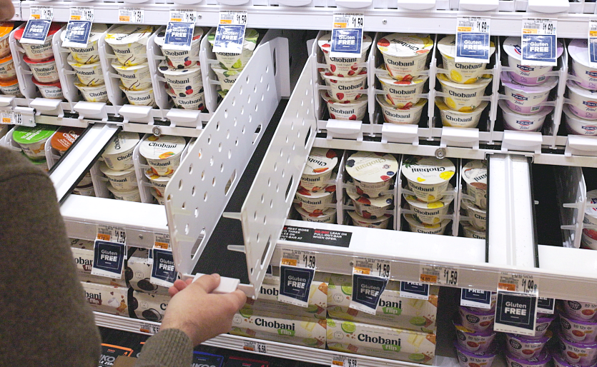
Two ways to load

Slide 27
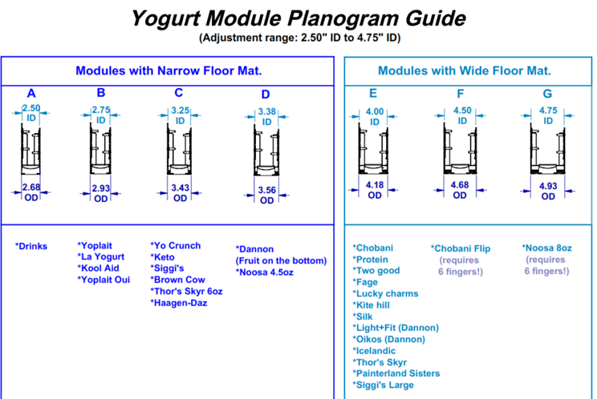
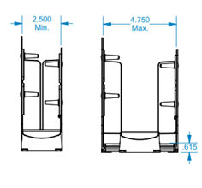
Modular Modules

Slide 28
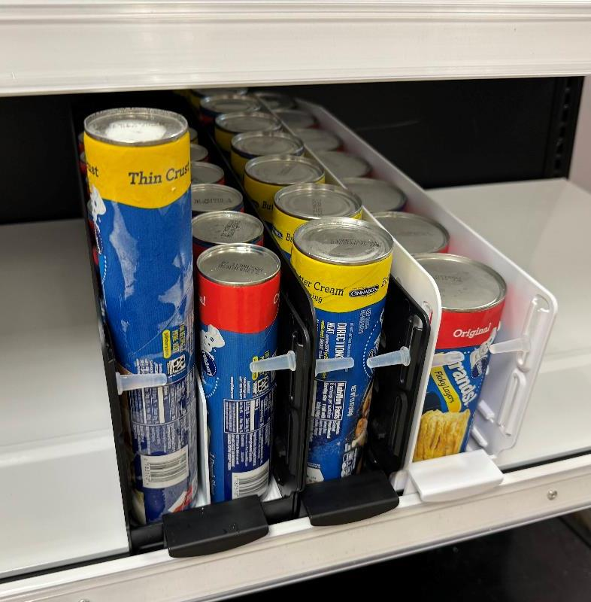
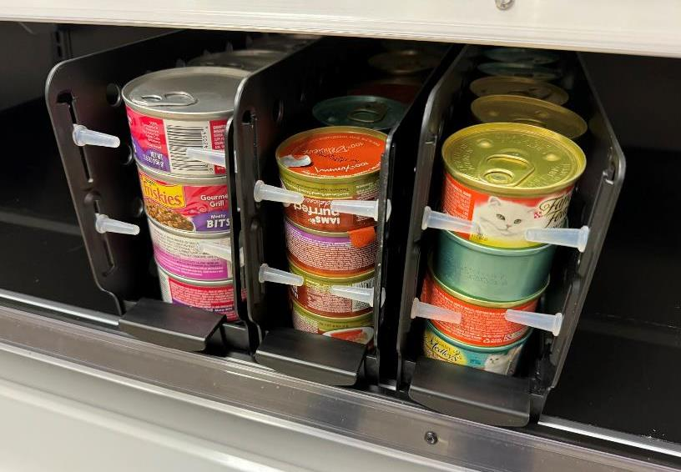
Development in other categories

Slide 29
Key Benefits
Gravity Fed Products
Modularity of Modules
Labor Savings
Efficient Product Rotation
Optimized Shelf Organization

Slide 30
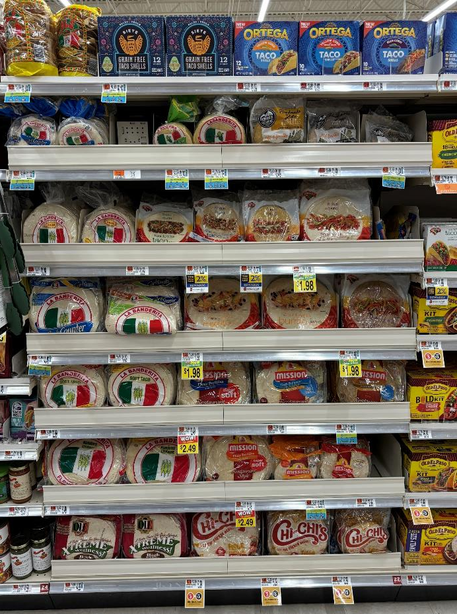
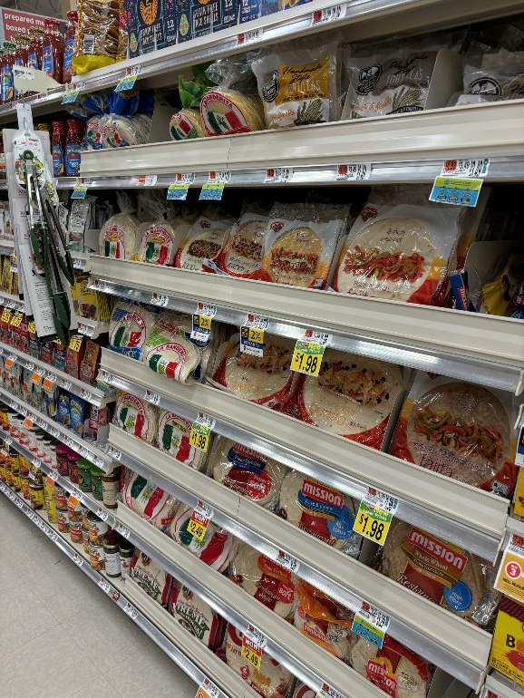
Tortilla Solution

Slide 31
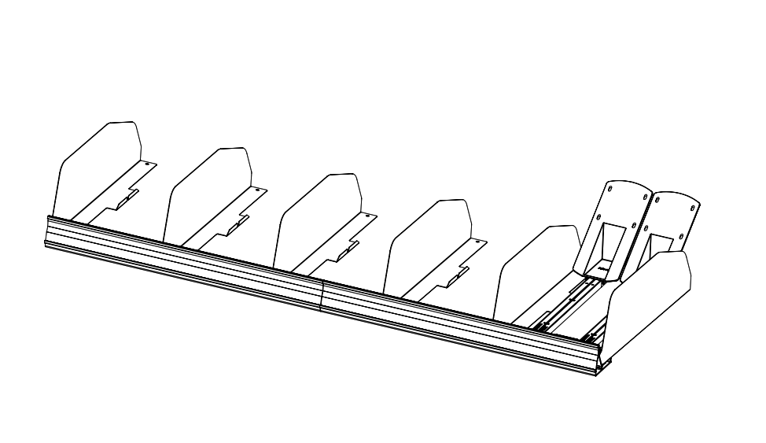
Features
- Front extrusion
- Metal dividers
- EZ Load pushers
- Angled paddle
- Bridge for double pushers
- Works with all sized tortillas
- Holds up to the weight of the product

Slide 32
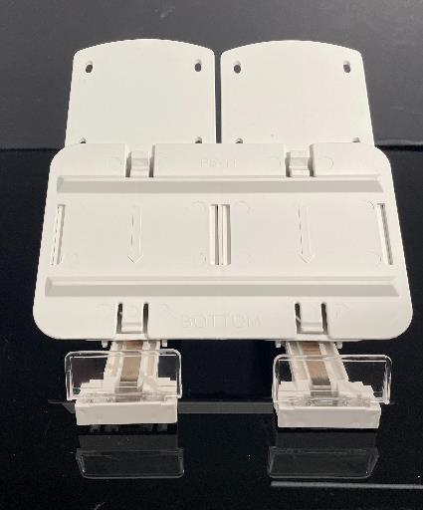
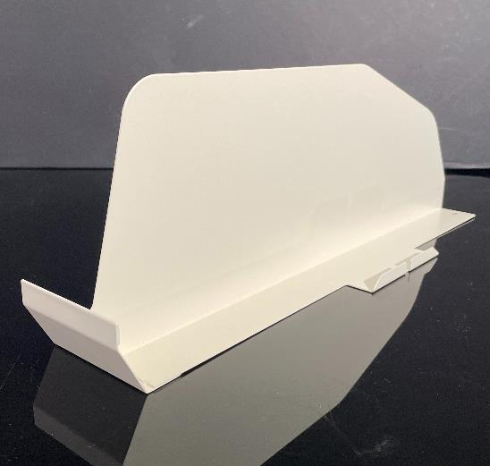
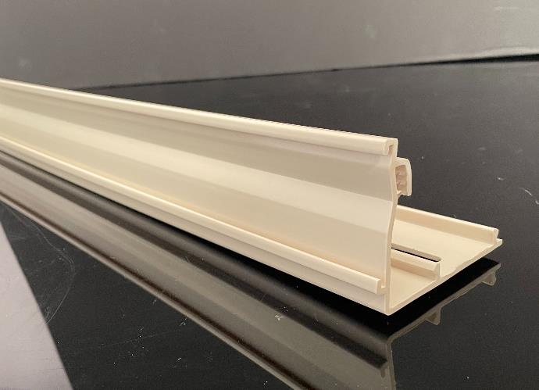
Tortilla Solution
Double pusher with angled sled and bridge plate
Metal divider: tabs into extrusion
Front extrusion: screws onto shelf

Slide 33
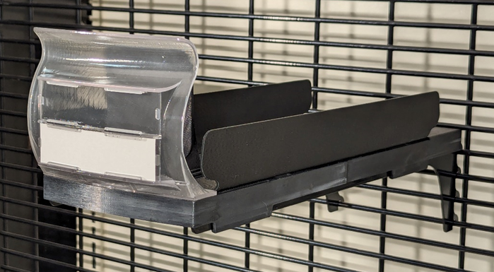

Hanging Tray

Slide 34

Features
- Modular hanging tray
- Short and tall lens
- Wide and narrow sides
- Hangs on grid or bar
- Sides adjustable to multiple widths
- Pullout tray for easy loading
- Two spring tension options
Used for multiple products:
- Salads
- Meats
- Cheese

Slide 35




Why Henschel is the best choice
Trusted
Proven
Innovative
Experienced
Whether it’s EZLoad or custom displays, customers rely on our solutions to elevate their brands
Our award-winning displays are currently in the top 100 retailers and CPG companies in the USA
Our expansive network of designers, engineers, and dedicated sales professionals all think outside the box, and work within budget
Henschel Steinau has been working the PoP market for more than 65 years, always driving to grow your bottom line

Slide 36




Noah Allen
301-518-2772
50 Commerce Drive
Allendale, NJ
Nallen@hspop.com
Thank you!

